Slide 1
Sustainable Web Design Bygning af et grønnere internet
Xbi @eamv 2025 v.1.5
Notes:
Start with a strong, visually engaging slide to draw the audience in.

Slide 2
This course is not for green washing!

Slide 3
Hvorfor er det relavant til DMUer?

Slide 4
Der er både sustainable software og sustainable web...

Slide 5

Internettets miljøpåvirkning
The internet significantly contributes to global carbon emissions.
- The internet produces approximately 3.7% of global carbon emissions.
If the internet was a country, it would rank sixth for electricity usage
Notes:
https://gydeline.com/facts/internet-electricity-usage/

Slide 6
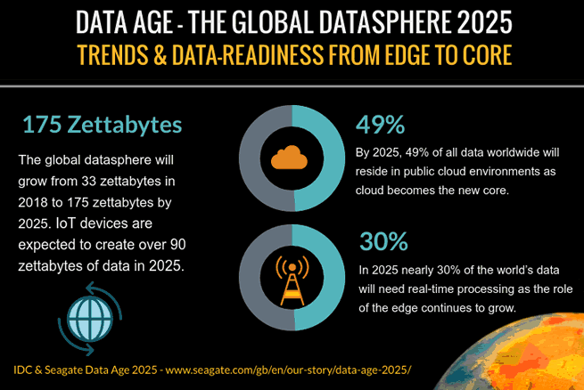
Den voksende appetit på data
Web traffic increased by 440% between 2015 and 2021.
- This growth contributes to more energy consumption and emissions.
Notes:
Visual data will enhance the understanding of this point.

Slide 7
Skjulte miljøomkostninger
Data centers consume large quantities of water for cooling.
The production of hardware results in e-waste.
The internet impacts power consumption, and the use of natural resources.
Notes:
Broaden the perspective on the internet's environmental impact.

Slide 8
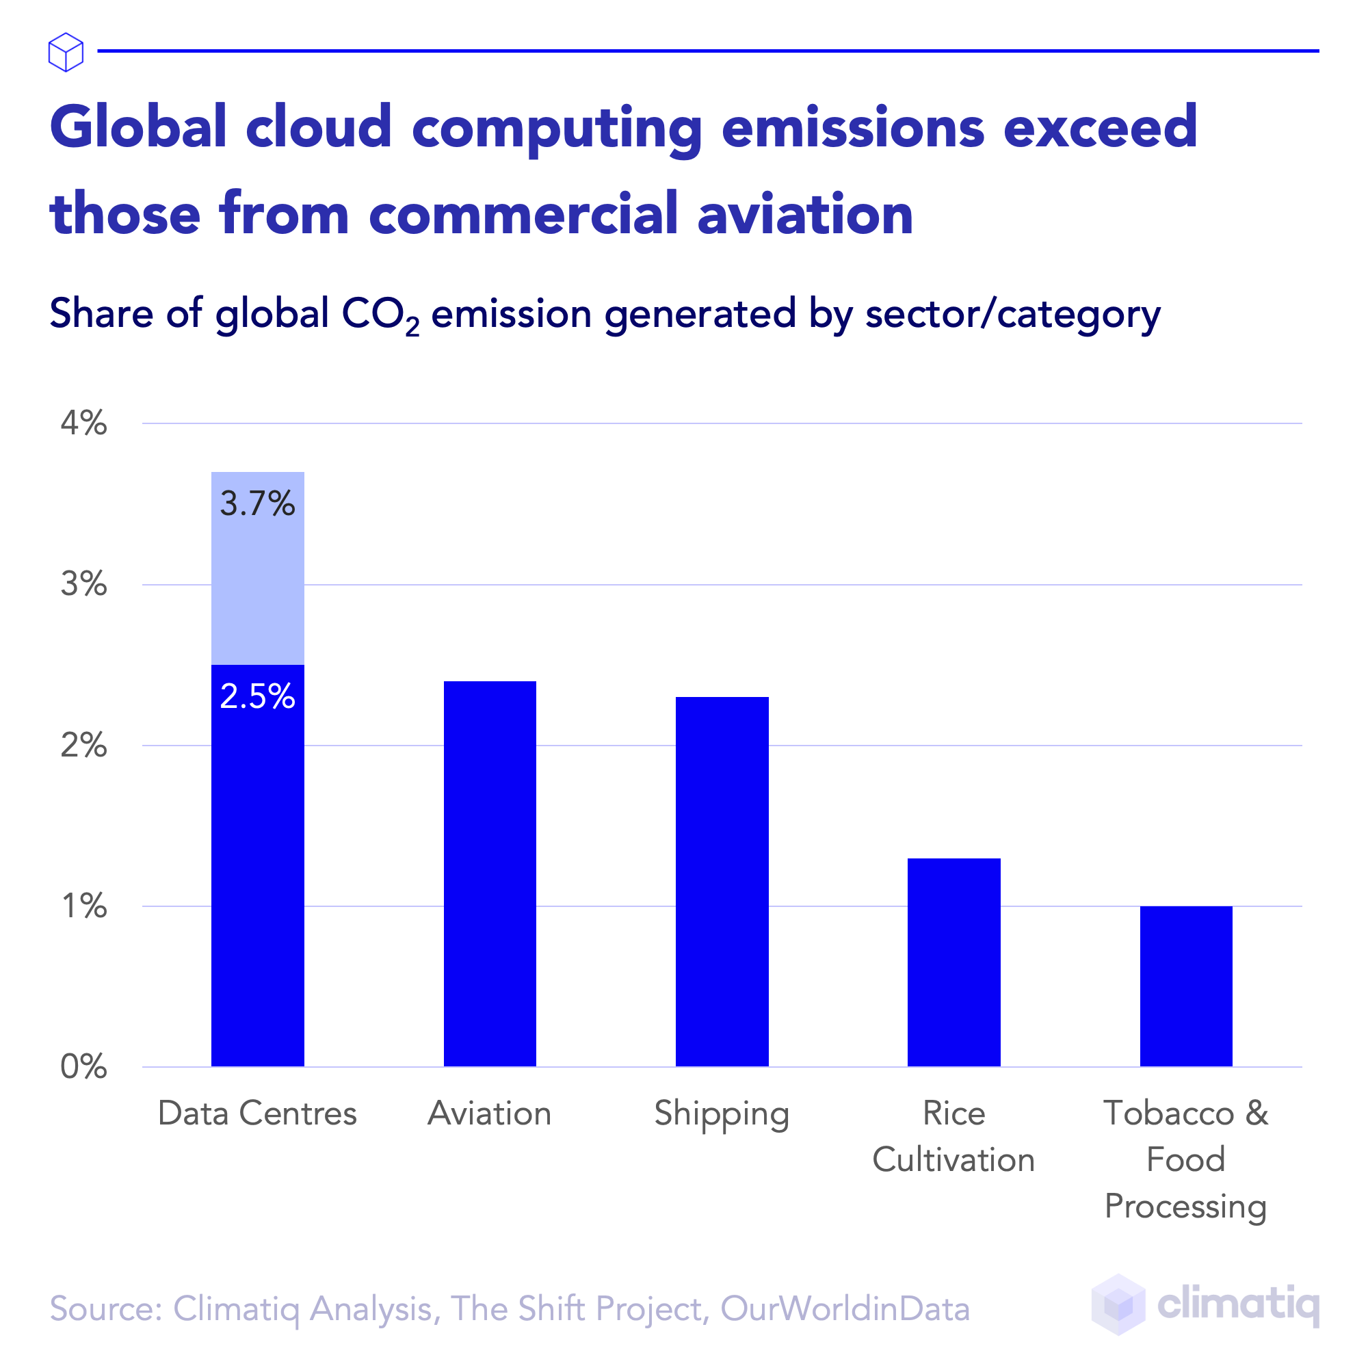

Slide 9
DR.dk = 69,5 MB
BT.dk = 24,4 MB
EB.dk = 21,1 MB
TV2.dk = 18,6 MB
Jyllands-posten.dk = 18,2 MB
Berlingske.dk = 16,4
KK.Dk = 1,3 MB
Organic Bacis (low impact) = 751 kB
Notes:
Det I ser her er version 1 af Klimavenlig visning.
Vi gik i luften med løsningen i juni måned og har flere tilføjelser på vej. Mere om det senere.

Slide 10
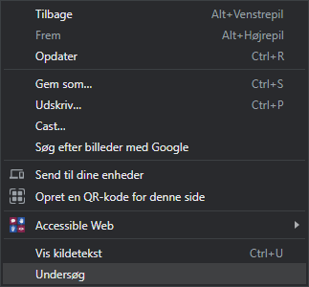
Find frem til eamv dataforbrug
Vælg Undersøg
Vælg Netværk
Genindlæs siden, så den begynder at registrere data
.

Slide 11
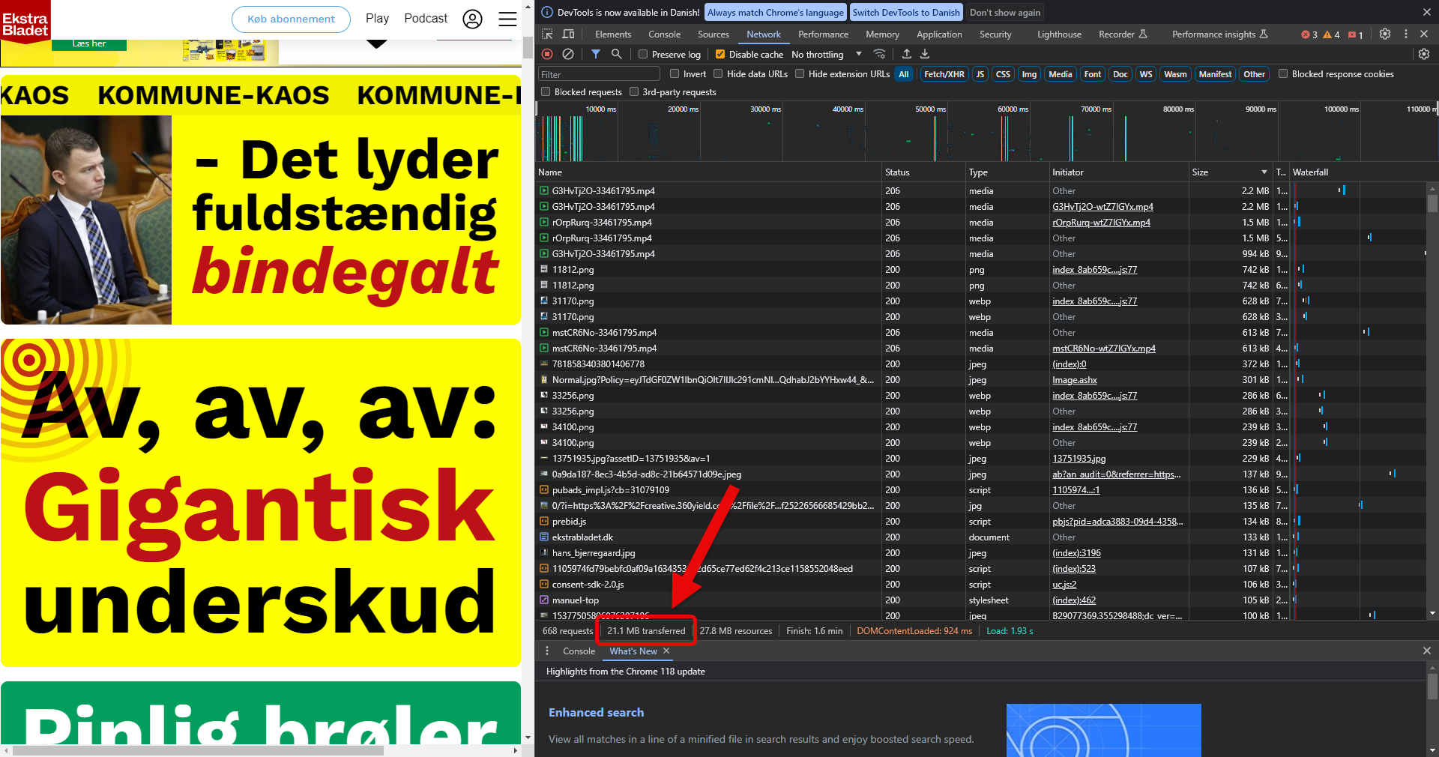

Slide 12
Definition af bæredygtigt webdesign
Sustainable web design prioritizes both people and the planet.
It's an approach to delivering digital products, services, and data responsibly.
It adheres to the principles of the Sustainable Web Manifesto.
Notes:
Clearly define the term 'sustainable web design.'

Slide 13
Øvelse
3 stik ord fra bogen 'sustainable web design'

Slide 14
Bæredygtig Webdesignpraksis I
Optimering af Billedformater for Hurtigere Indlæsning
Reducerede indlæsningstider ved at konvertere store billedfiler til mere effektive formater (f.eks. WebP).
Implementerede responsive billeder for at vise passende størrelser afhængigt af skærmopløsning.
Resultat: Mindre energi forbundet med servere og hurtigere brugeroplevelse.
Værktøj https://tinypng.com/
Notes:
Explain that sustainability is an integrated approach.

Slide 15
Bæredygtig Webdesignpraksis II
Designkomponenter til Genbrug
Oprettet standardkomponenter som knapper og navigationsmenuer.
Genbrugsdesign på tværs af alle sider for at minimere kode og optimere ressourceforbrug.
Resultat: Effektivisering af udviklingsprocessen og lavere vedligeholdelsesomkostninger.

Slide 16
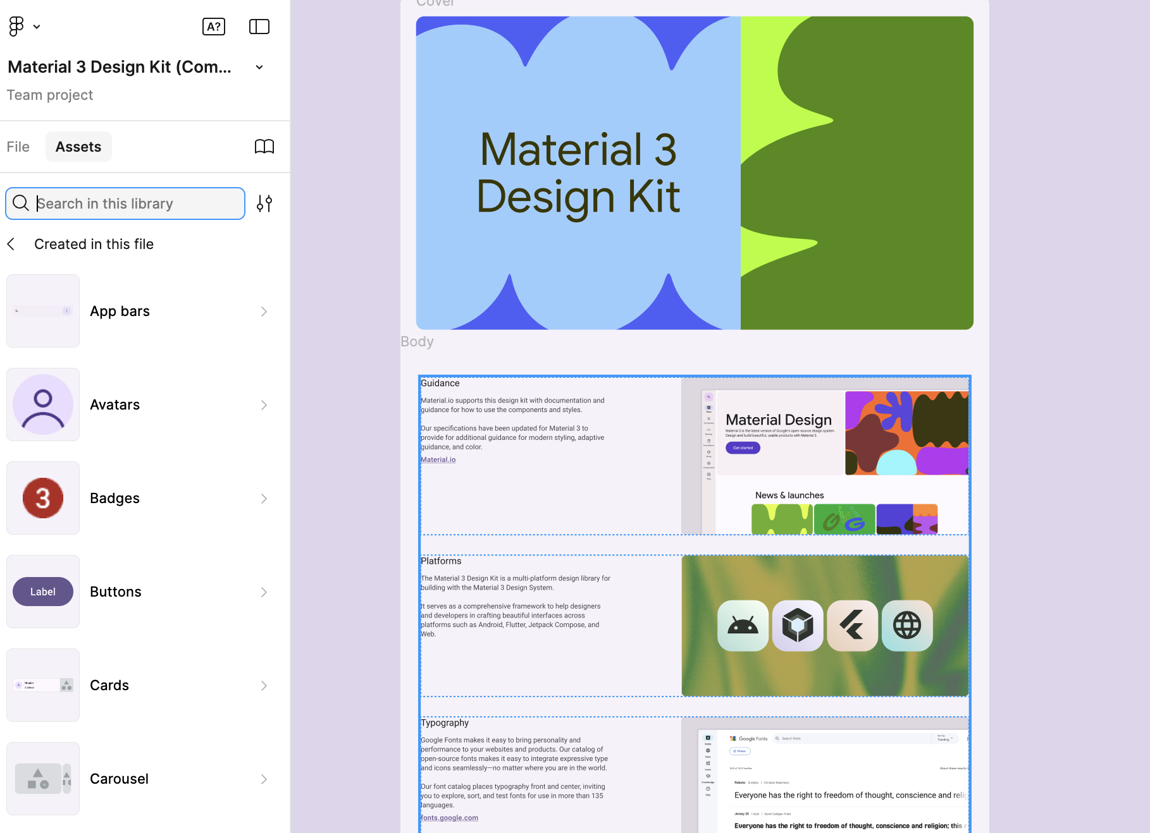

Slide 17
Effektive kodningspraksisser
Skriv genanvendelig og modulær kode.
Genanvendelig kode reducerer redundans og forbedrer effektiviteten.
Modulær kode gør det lettere at vedligeholde og opdatere websites.
Notes:
e.g..

Slide 18
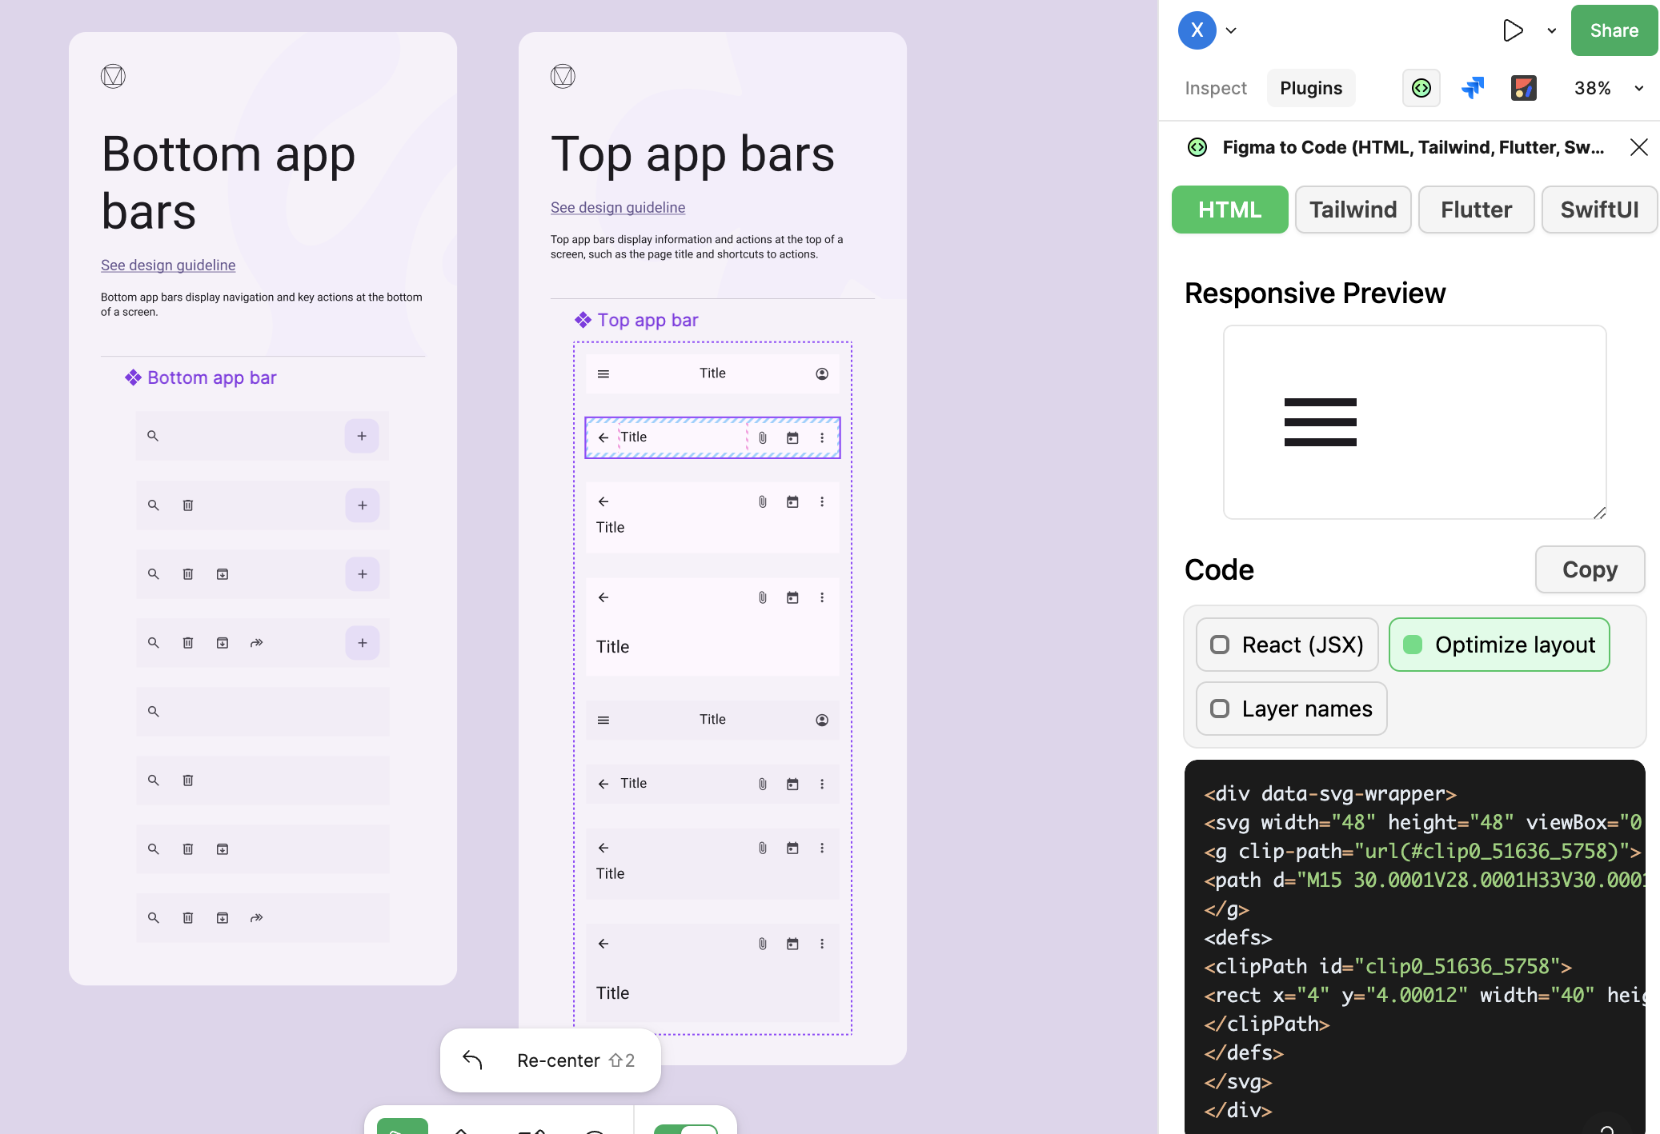
Google material design

Slide 19
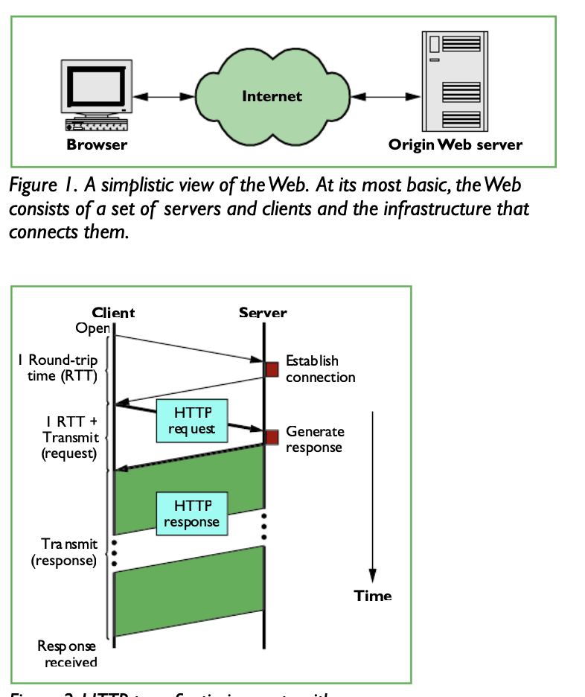
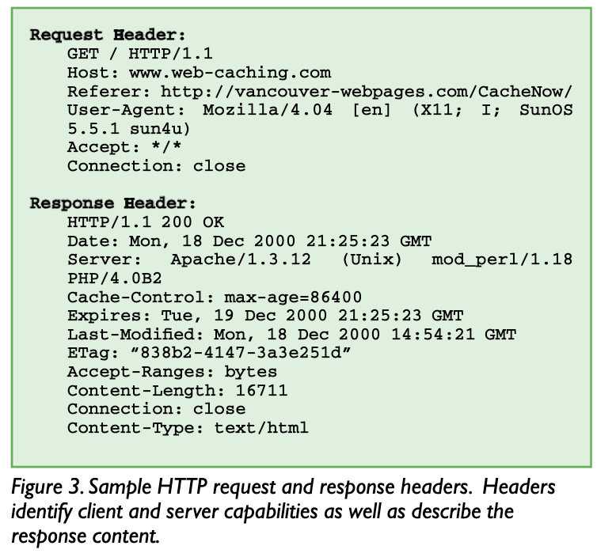
Bæredygtig Webdesignpraksis III
1Caching Techniques
https://www.researchgate.net/publication/2570397_A_Web_Caching_Primer

Slide 20
.htaccess
<IfModule mod_expires.c>
ExpiresActive On
# Billeder
ExpiresByType image/jpg "access plus 1 year"
ExpiresByType image/jpeg "access plus 1 year"
ExpiresByType image/png "access plus 1 year"
ExpiresByType image/gif "access plus 1 year"
# CSS og JavaScript
ExpiresByType text/css "access plus 1 month"
ExpiresByType application/javascript "access plus 1 month"
# PDF-filer
ExpiresByType application/pdf "access plus 1 month"
# Webfonte
ExpiresByType font/woff2 "access plus 1 year"
ExpiresByType font/woff "access plus 1 year"
ExpiresByType font/ttf "access plus 1 year"
</IfModule>

Slide 21
2 Use Content Delivery Network (CDN):
e.g.
https://getbootstrap.com/docs/5.3/getting-started/introduction/

Slide 22
Lazy Loading:
uses the Intersection Observer API to lazy load these images when they come into the viewport.
Notes:
Lazy load meaning that do not load the resouce

Slide 23
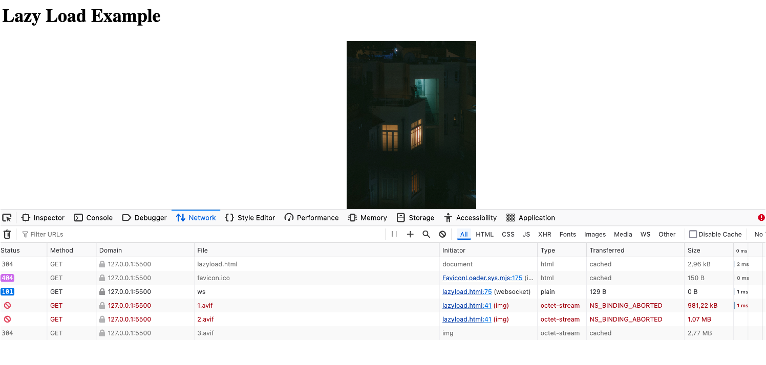
Notes:
Check the Network Activity:
Open the Developer Tools in your browser (usually by pressing F12 or Ctrl+Shift+I).
Go to the "Network" tab.
Reload the page and scroll down to where the images are supposed to appear.
Observe the network activity. You should see the image files being loaded only when they are about to come into the viewport.

Slide 24
Responsive Images:
<img src="small.jpg" srcset="medium.jpg 768w, large.jpg 1200w">
If the viewport is less than 768 pixels wide, the browser will use the image specified in the src attribute (small.jpg).
If the viewport is at least 768 pixels wide but less than 1200 pixels wide, the browser will use medium.jpg.
If the viewport is 1200 pixels wide or wider, the browser will use large.jpg.

Slide 25
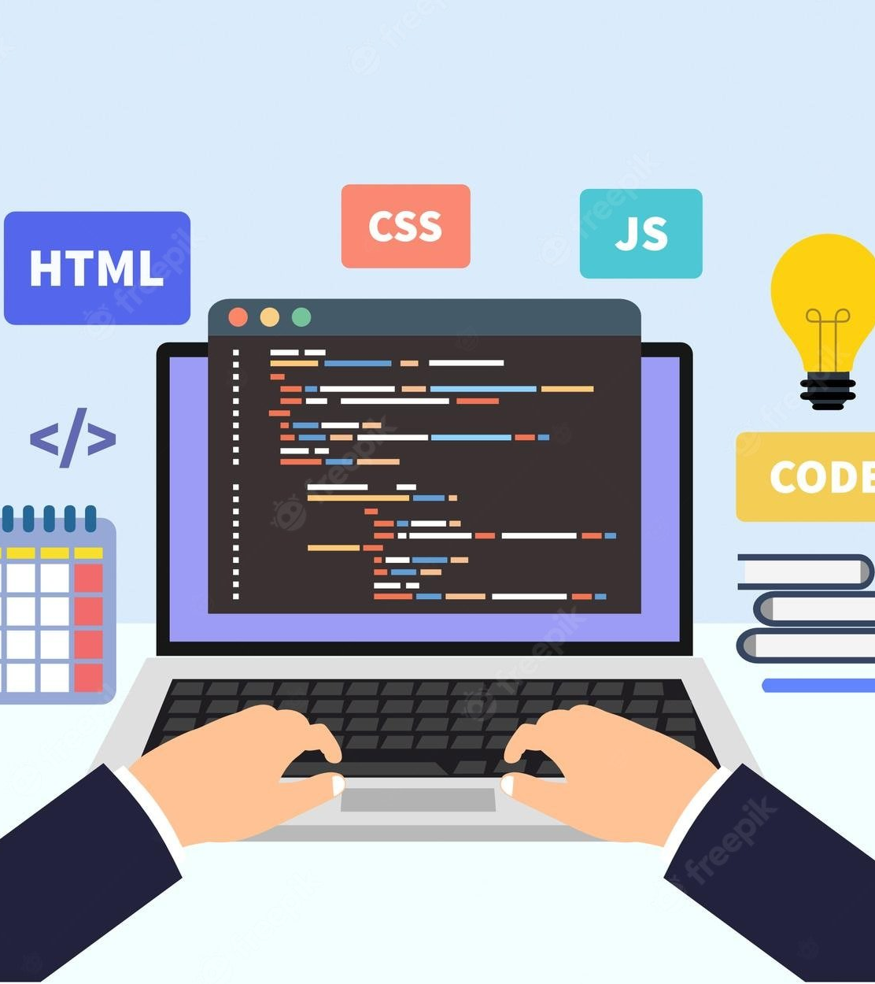
Web Developers
Web developers have a critical role in creating sustainable digital solutions.
They are responsible for the design and maintenance of websites and applications.
Their choices directly affect the internet's carbon footprint.
Notes:
Highlight the responsibility of web developers in creating sustainable solutions.

Slide 26
Bedste praksis

Slide 27
Implementering af bæredygtige web praksis
Fokus på at reducere sidens vægt og ressource forbrug.
Optimer billeder, skrifttyper og videoer.
Brug mørkere farver og systemskrifttyper.
Komprimer mediefiler.
Notes:
Demo _ light dark

Slide 28
Optimering af billeder for bæredygtighed
AVIF and WebP offer better compression than JPEG/PNG.

Slide 29
Optimering af video for bæredygtighed
Reduce Video Length and Resolution:
Trim unnecessary parts of the video.
Offer lower resolution options for users with lower bandwidth.

Slide 30
Optimering af skrifttyper for bæredygtighed
Eksterne skrifttyper kan øge sidens vægt og energiforbrug.
Brug systemskrifttyper, hvor det er muligt.
Delmængde skrifttyper for at reducere filstørrelsen.
https://fonts.google.com/

Slide 31
Fordelene ved 'Dark Theme’
Mørk tilstand reducerer energiforbruget
Sort er den mest energieffektive farve på digital skærme.
Mørk tilstand kan nemt implementeres med få linjer kode(javascript eller CSS).
Notes:
https://www.linkedin.com/learning/hands-on-introduction-javascript/create-a-dark-mode-switch?resume=false&u=42436220
(media queery CSS)

Slide 32
'Dark Theme’ Demo

Slide 33
Sammenhængen mellem ydeevne (performace) og bæredygtighed
Website-ydeevne er afgørende for bæredygtighed.
Optimer loading speed for websites.
Hurtigt indlæste sider bruger mindre energi.

Slide 34
Minificering af kode til produktion
Minificering af CSS reducerer filstørrelsen og forbedrer ydeevnen.
Fjern unødvendige mellemrum, kommentarer og linjeskift.
Minificeret CSS indlæses hurtigere og reducerer sidens vægt.
https://freecodetools.org/minifier/
Notes:
Minify Your HTML, CSS, and JavaScript

Slide 35
Bedste praksis specification/standard

Slide 36
Web-bæredygtighed (WSG)
WSG: En W3C gruppe med fokus på fællesskabsengagement og deling af information.
https://www.w3.org/blog/2023/introducing-web-sustainability-guidelines/

Slide 37
WSG
4 big pieces:
User Experience Design: “research and ideation, journey design, content and assets, and quality assurance.”
Web Development: “development approach, code minimization, code coherence, and code security.”
Hosting / infrastructure: “environment commissioning, minimizing environment and data, and minimizing human disruption.”
Business strategy / Product management: “reporting, disclosure, strategy, and policies from both an organizational and website / product level.”

Slide 38
WSG og WCAG
WCAG: Et formelt sæt af tekniske standarder, som webudviklere og designere skal følge for at skabe tilgængelige hjemmesider.
WSG: Fremmer bedste praksis, men har ikke håndhævelige retningslinjer.

Slide 39
Øvelse: Udforskning af bæredygtigt webdesign
Arbejde I Grupper, Besøg Web Sustainability Guidelines (WSG) 1.0.
Find 2 UX-eksempler: Tilgængelighed, ydeevne, brugervenlighed.
Find 2 udviklereksempler: Effektiv kodning, ressourcehåndtering, energiforbrug.
Find 2 Business og Hosting
Dokumentér fund: Opsummer med skærmbilleder/links.
Diskussion: Forbered til diskussion i klassen.

Slide 40
Fordele ved bæredygtigt webdesign
Bæredygtige praksisser resulterer i flere fordele.
Reducerer CO2-udledninger.
Spar energi og ressourcer.
Forbedrer hjemmesidens ydeevne.
Forbedrer brugeroplevelsen.
Øger forbrugernes tillid.

Slide 41
Værktøjer til måling og forbedring af bæredygtighed
• Værktøjer er tilgængelige til at måle og forbedre en hjemmesides bæredygtighed.
• Website Carbon Calculator estimerer en hjemmesides udledninger.
https://www.websitecarbon.com/

Slide 42
Exercise 1-til tirsdag uge 9
Vælge en –Gruppe skal test med carbon test , find ud af
Hvilken teknologi bruger dette websted?
https://www.herning.dk/ 1 Simon, Tobias og Alexander
https://www.kk.dk/ 2 Anders, Ebbe, Sarah
https://skive.dk/ 3 Sebastian, Simon og Rasmus
https://sonderborg.dk/ 4 Mark, Jacob, Sabina og Simone
https://struer.dk/ 5 karl emil og hp
https://www.billund.dk/ 6 Viktor og Victor
https://www.holstebro.dk/ 7 umutcan og jacob

Slide 43
Exercise2
Test :What factors contribute to the differences in carbon emissions? Consider:
How are the site made of ?
Page size (MB)
Complexity of the design (heavy media, JavaScript, animations, etc.)

Slide 44
Exercise 2 continued
Google PageSpeed Insights – Analyzes page speed and optimization but doesn’t directly show size.
Or Chrome->lighthouse
Or Firefox (DevTools)
1. Open the website and inspect
2. Navigate to the Network tab.
3. Reload the page and check the Total Size at the bottom.

Slide 45
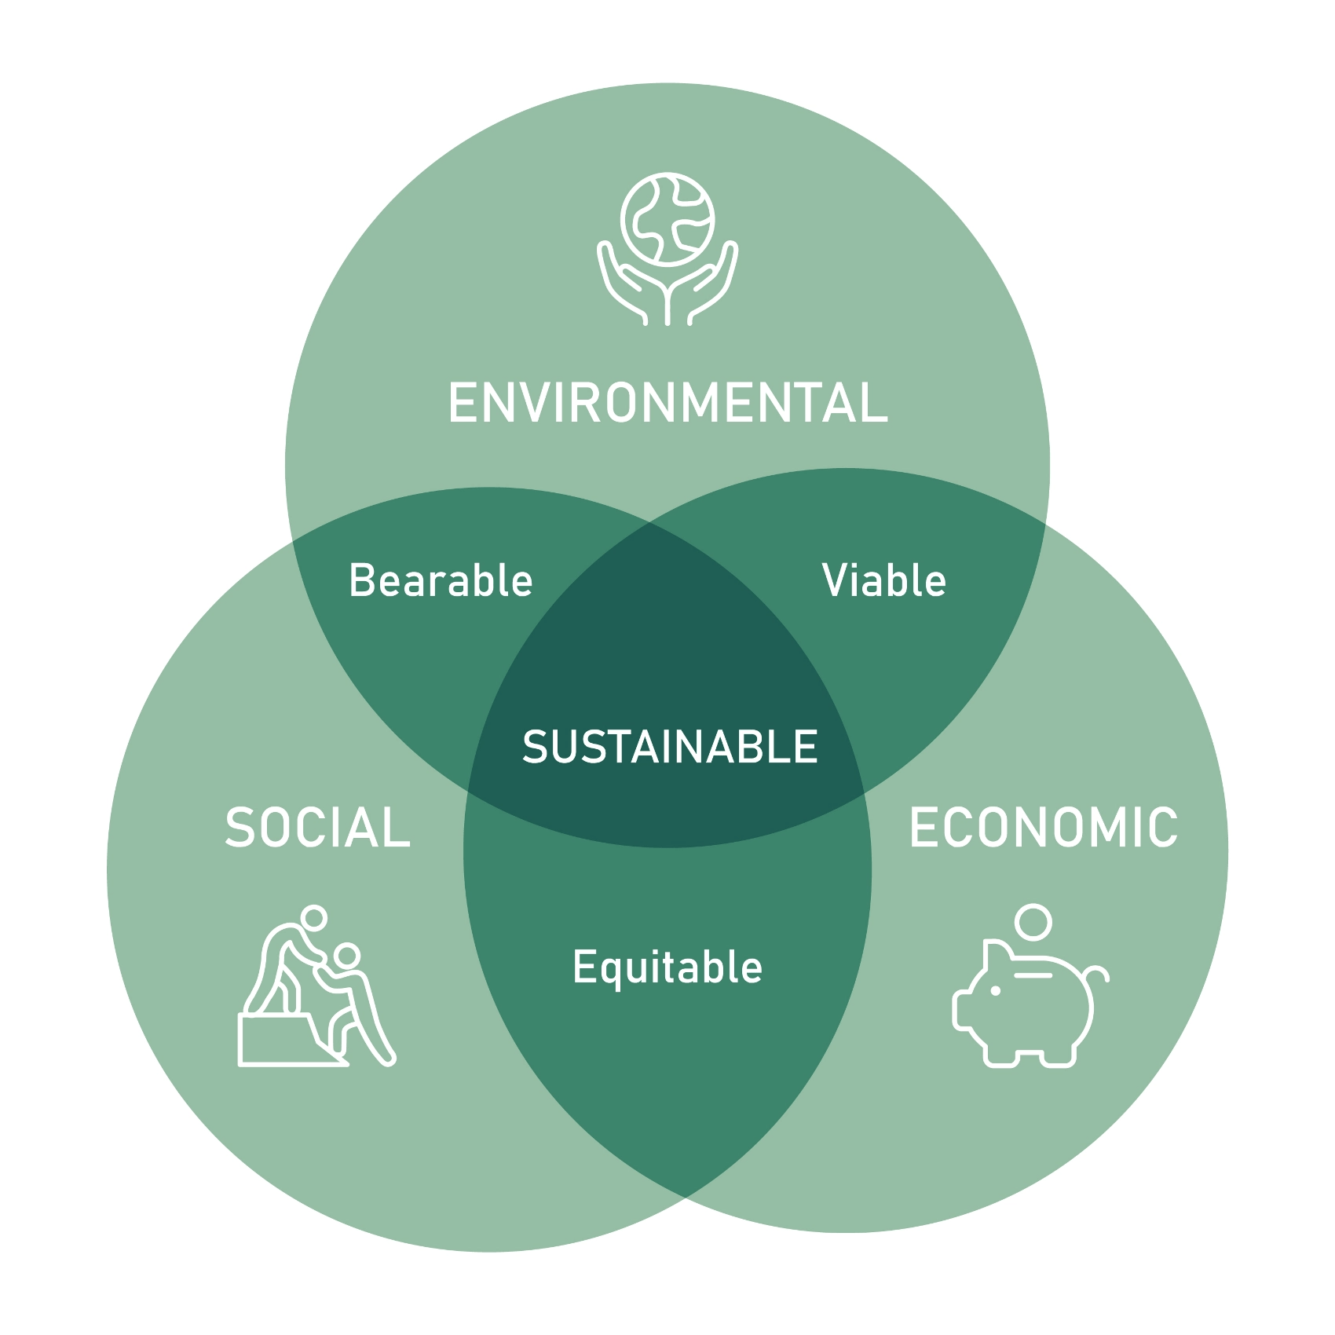
Not just about CO2

Slide 46
Reflection Questions
What is Sustainable Web Design?
How would you define sustainable web design in your own words?
Why is it important to consider sustainability in web development?
Practical Applications
Can you think of any examples where sustainable web practices could be applied in your current or future projects?
What challenges might you face when implementing these practices?

Slide 47
Discussion Points
Impact on the Environment
How does optimizing images, videos, and code contribute to reducing the environmental impact of websites?
What other web design practices can help minimize energy consumption?
Personal Commitment
What steps can you take to incorporate sustainable practices into your daily work as a web developer?

Slide 48
Discussion Points 2
Mange webudviklere er opmærksomme på internettets miljøpåvirkning, men ikke konsekvent bruger bæredygtige metoder. Hvorfor tror I, at der er denne forskel mellem viden og handling?

Slide 49
Sustainability + Accessibility in Web Design
Energy Efficiency & Accessibility Align
Lightweight, optimized websites load faster and consume less energy, benefiting both users on slow connections and the planet.
Inclusive Design Reduces Waste
Websites designed for all users (including those with disabilities) prevent rebuilds and excessive redesigns, saving time and resources.
Better UX = Lower Energy Use
Clear navigation & readable fonts reduce user frustration and time spent searching, leading to lower server requests and energy consumption.
Notes:
SUS - Reduce data transfer by optimizing images, videos, and code.
- Use green hosting providers to lower carbon footprint.
- Implement dark mode and energy-efficient colors.
A11y
- Ensure websites are usable for people with disabilities (WCAG guidelines).
- Provide alt text for images and use semantic HTML.
- Optimize keyboard navigation and screen reader support.

Slide 50
kilder
Greenwood, T. (2021). Sustainable Web Design A book apart
Hulleberg, O., Granum, H. L., Hansen, S. G., Moen, M., Monllaó, C. V., & Inal, Y. (2023). The Awareness and Practices of Web Developers Toward Sustainable Web Design. In HCII 2023, LNCS 14030, pp. 134–145. Springer.1...
WAI Policy. (n.d.). Web accessibility laws & policies. Retrieved from
Green Software Foundation. . Green Software Foundation. Retrieved February 3, 2025, from http://greensoftware.foundation/
The Green Web Foundation. The Green Web Foundation. Retrieved February 3, 2025, from https://www.thegreenwebfoundation.org/

